Slide 1

Arthur Griffin, Jr.
May 18, 2021

Slide 2
Talent Delayed - Talent Denied
Americans have long been trained to see deficiencies of African Americans rather than deficiencies of public policy and practice
“Just is….. is not….. Justice”

Slide 4
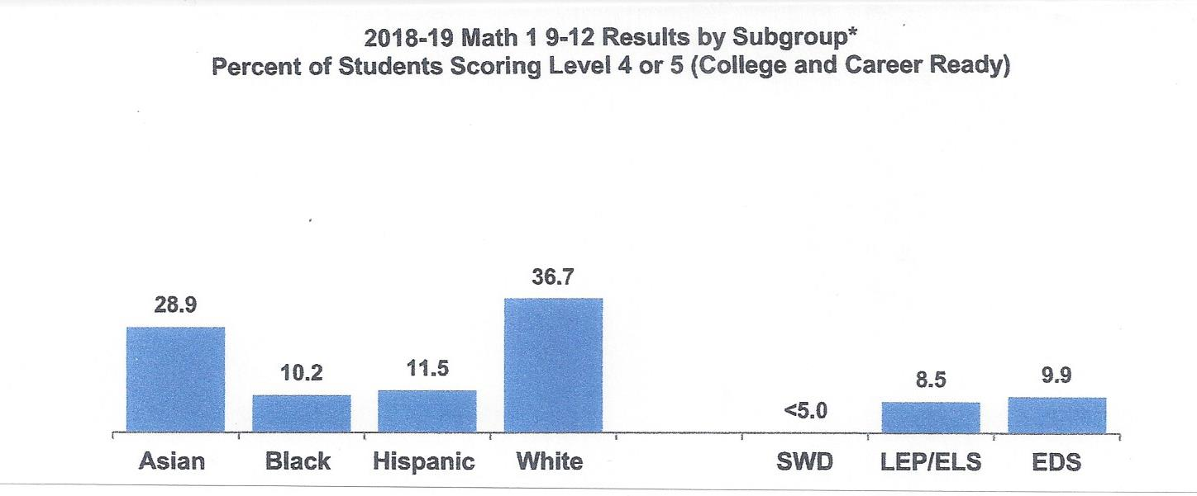
Source: CMS 2021-22 Budget Book, pp. 67-68; SWD=Students With Disabilities; LEP=Limited English Proficient;
ELS=English as a Second Language; EDS=Economically Disadvantaged Student

Slide 5
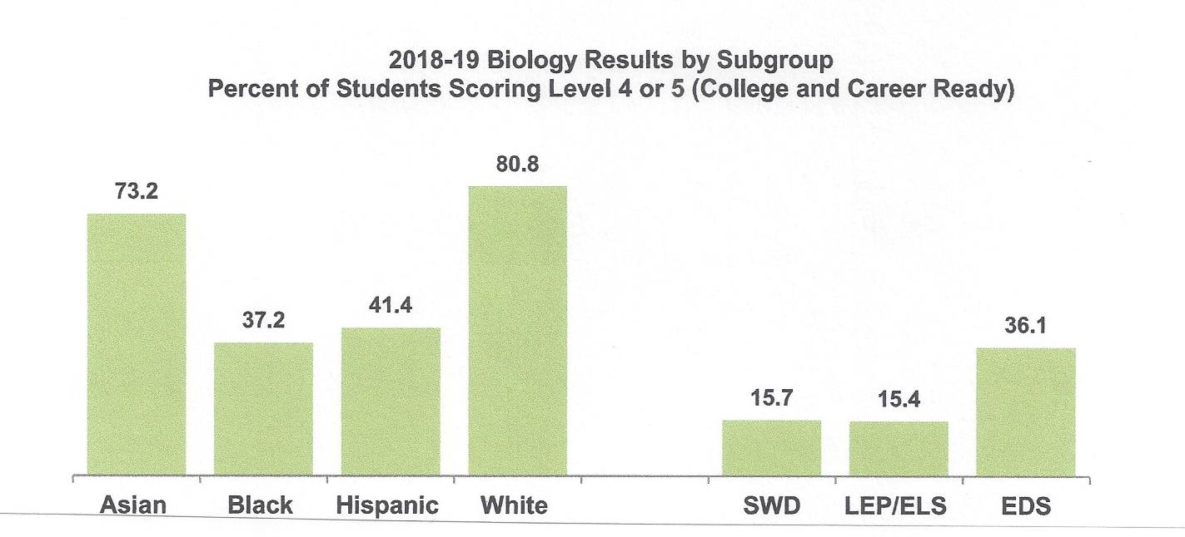
Source: CMS 2021-22 Budget Book, pp. 67-68; SWD=Students With Disabilities; LEP=Limited English Proficient;
ELS=English as a Second Language; EDS=Economically Disadvantaged Student

Slide 6
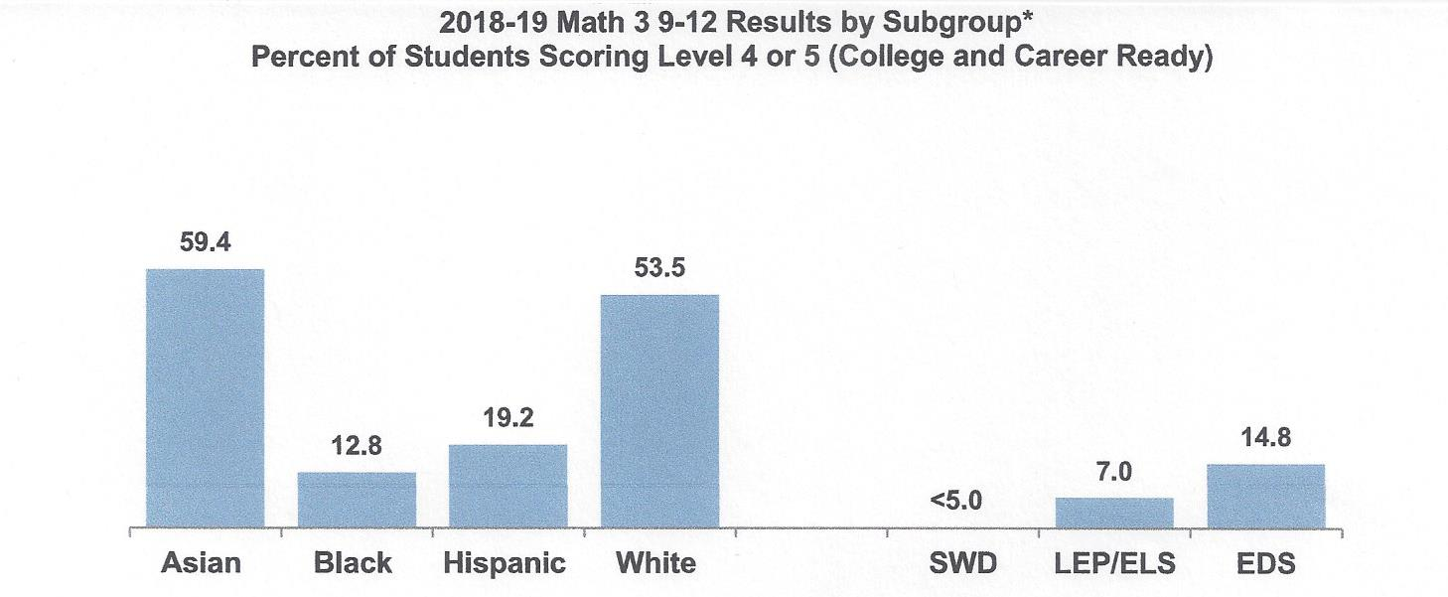
Source: CMS 2021-22 Budget Book, pp. 67-68; SWD=Students With Disabilities; LEP=Limited English Proficient;
ELS=English as a Second Language; EDS=Economically Disadvantaged Student

Slide 7
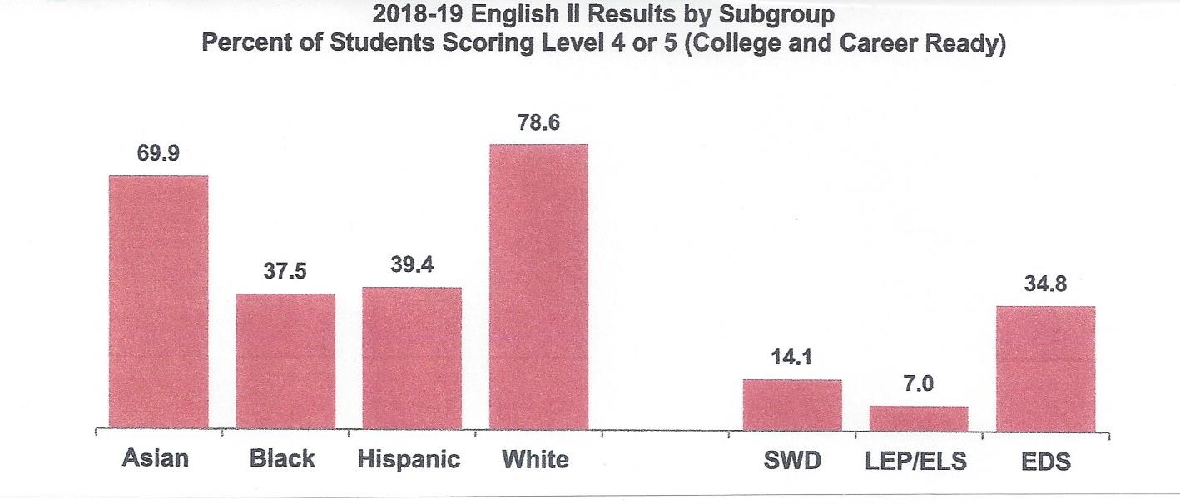
Source: CMS 2021-22 Budget Book, pp. 67-68; SWD=Students With Disabilities; LEP=Limited English Proficient;
ELS=English as a Second Language; EDS=Economically Disadvantaged Student

Slide 8
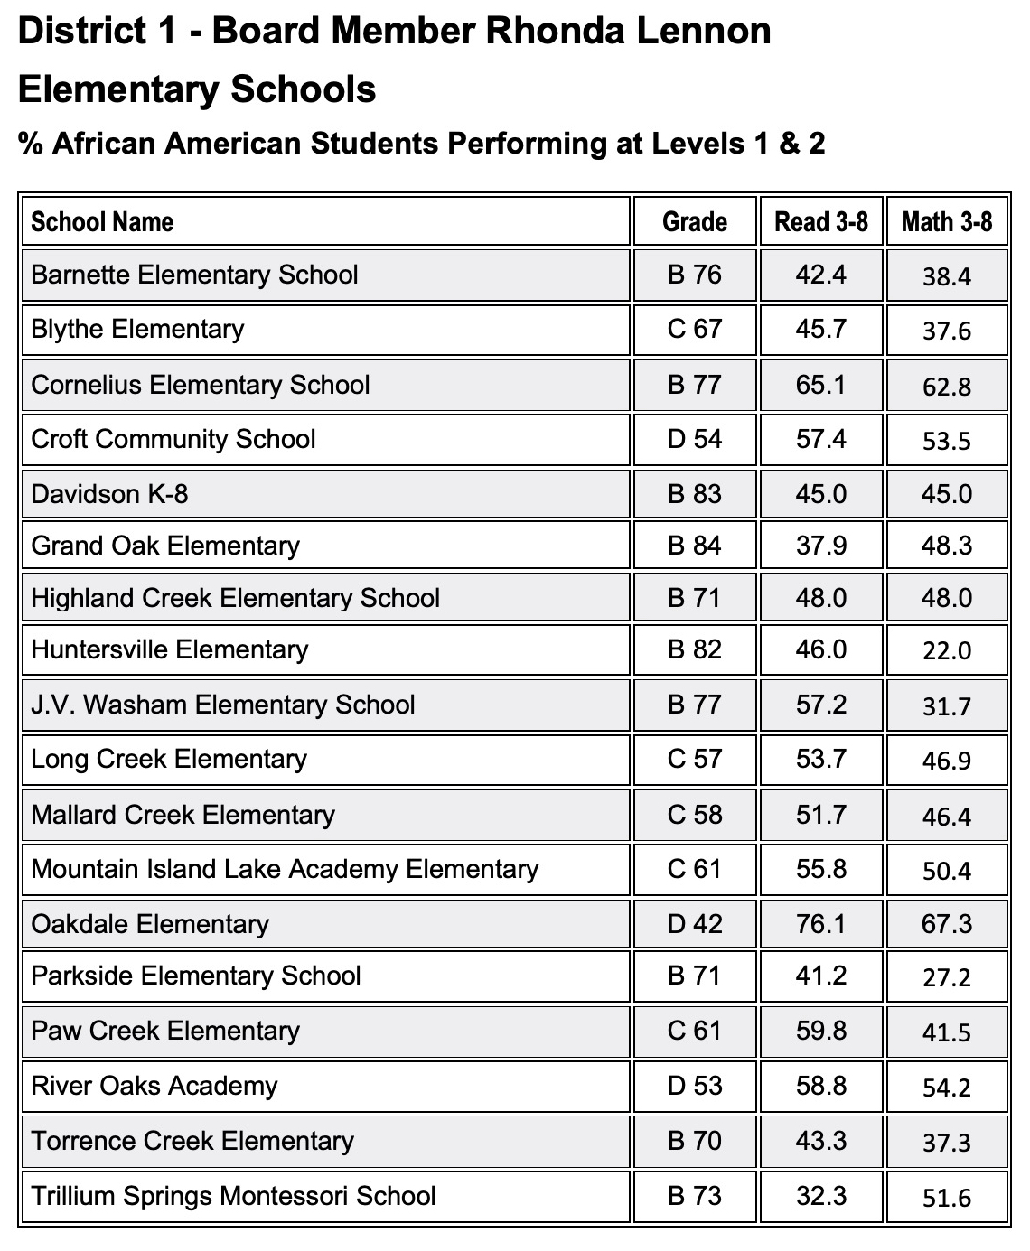
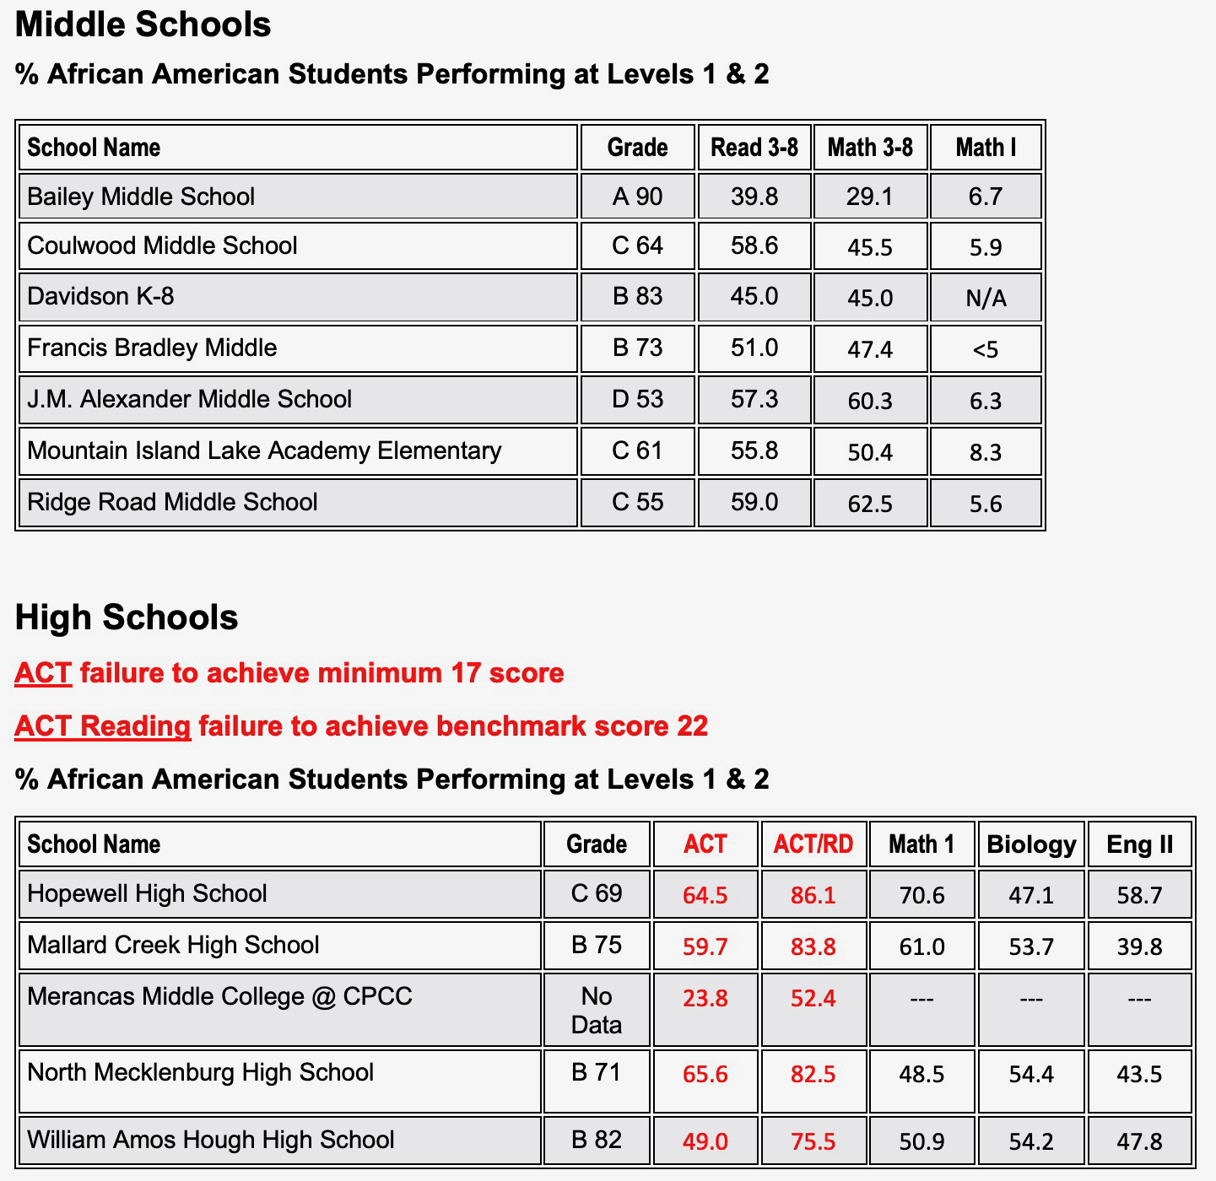
Source: NC Dept. of Public Instruction ; download at https://files.nc.gov/dpi/data-report2019_final.xlsx

Slide 9
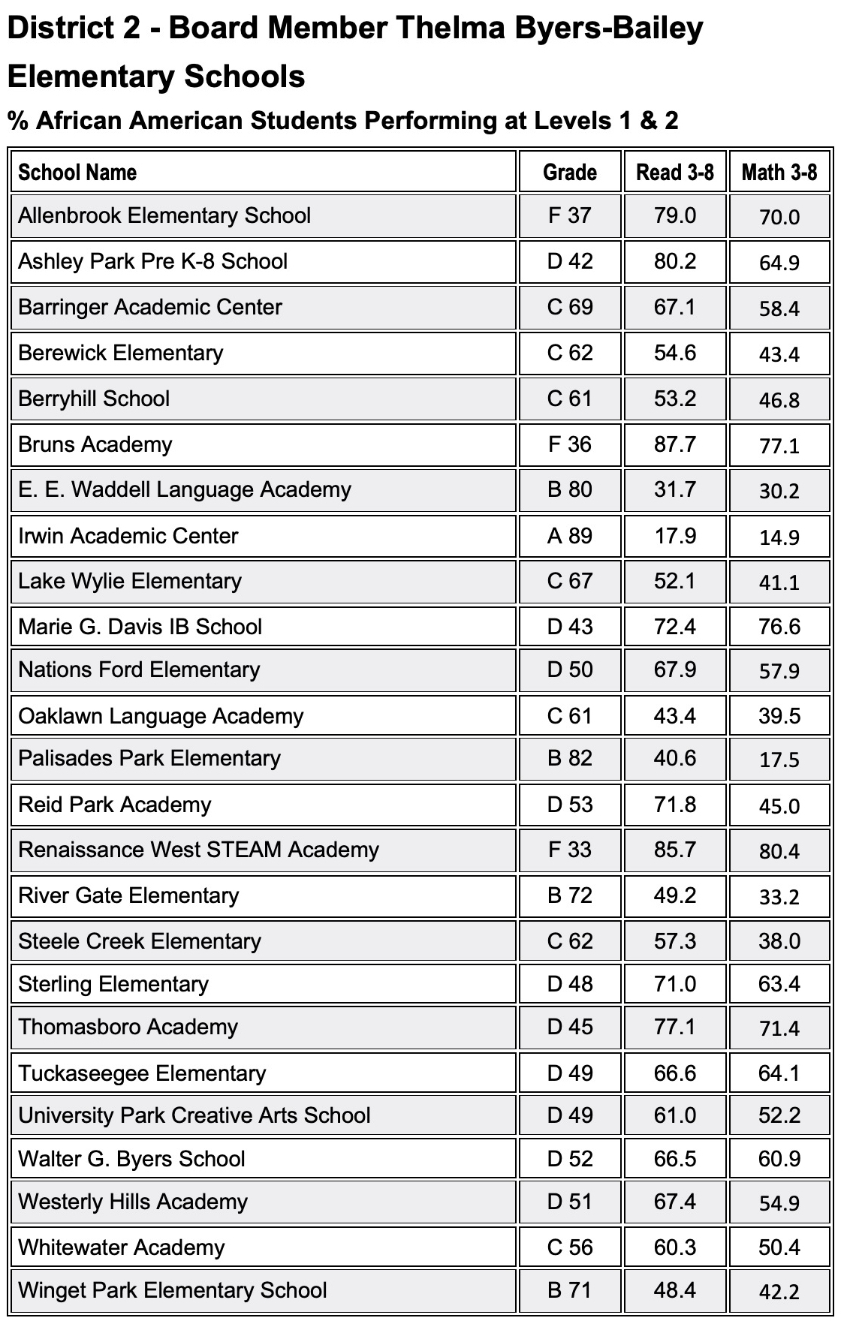
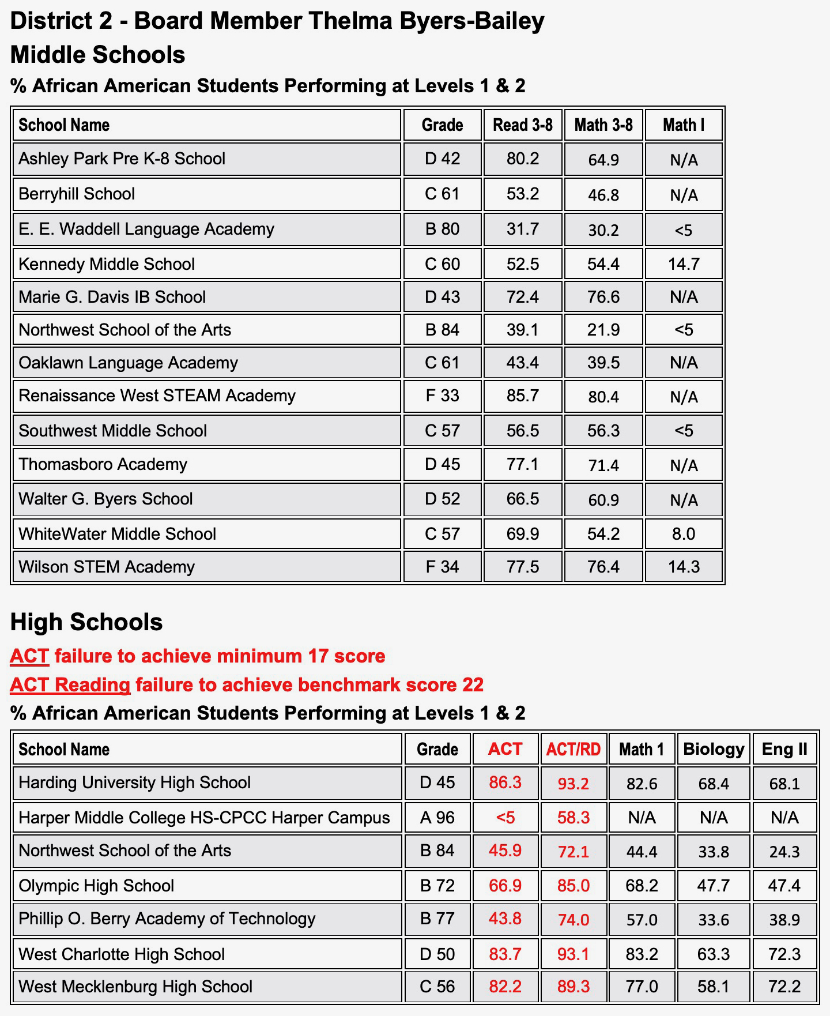
Source: NC Dept. of Public Instruction ; download at https://files.nc.gov/dpi/data-report2019_final.xlsx

Slide 10
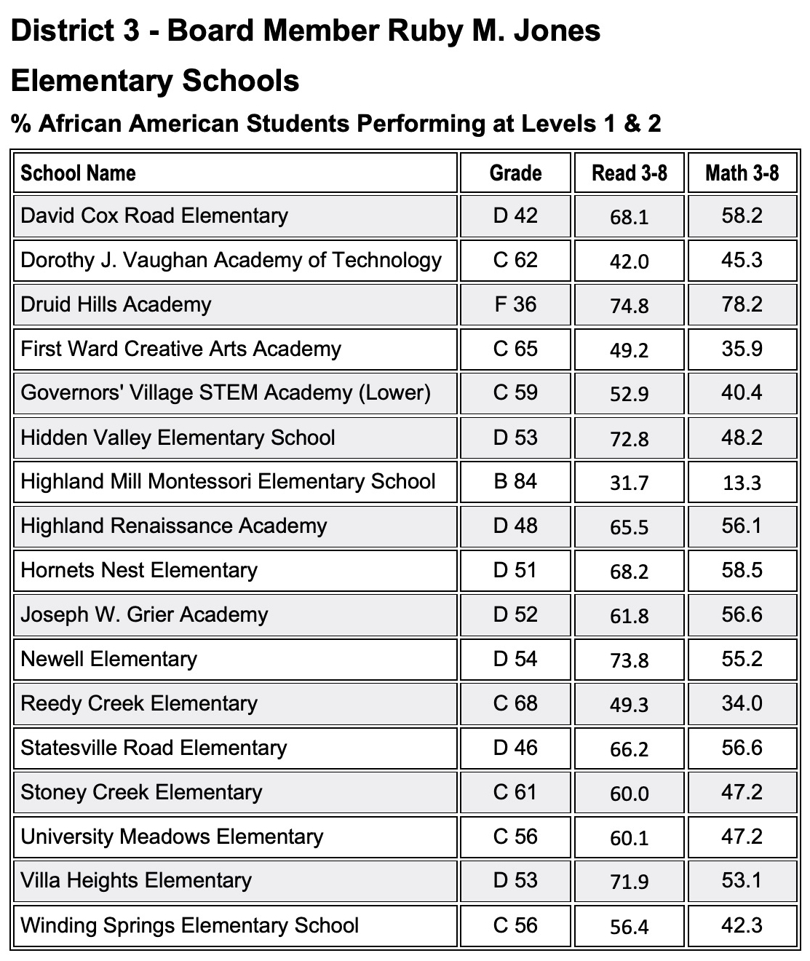
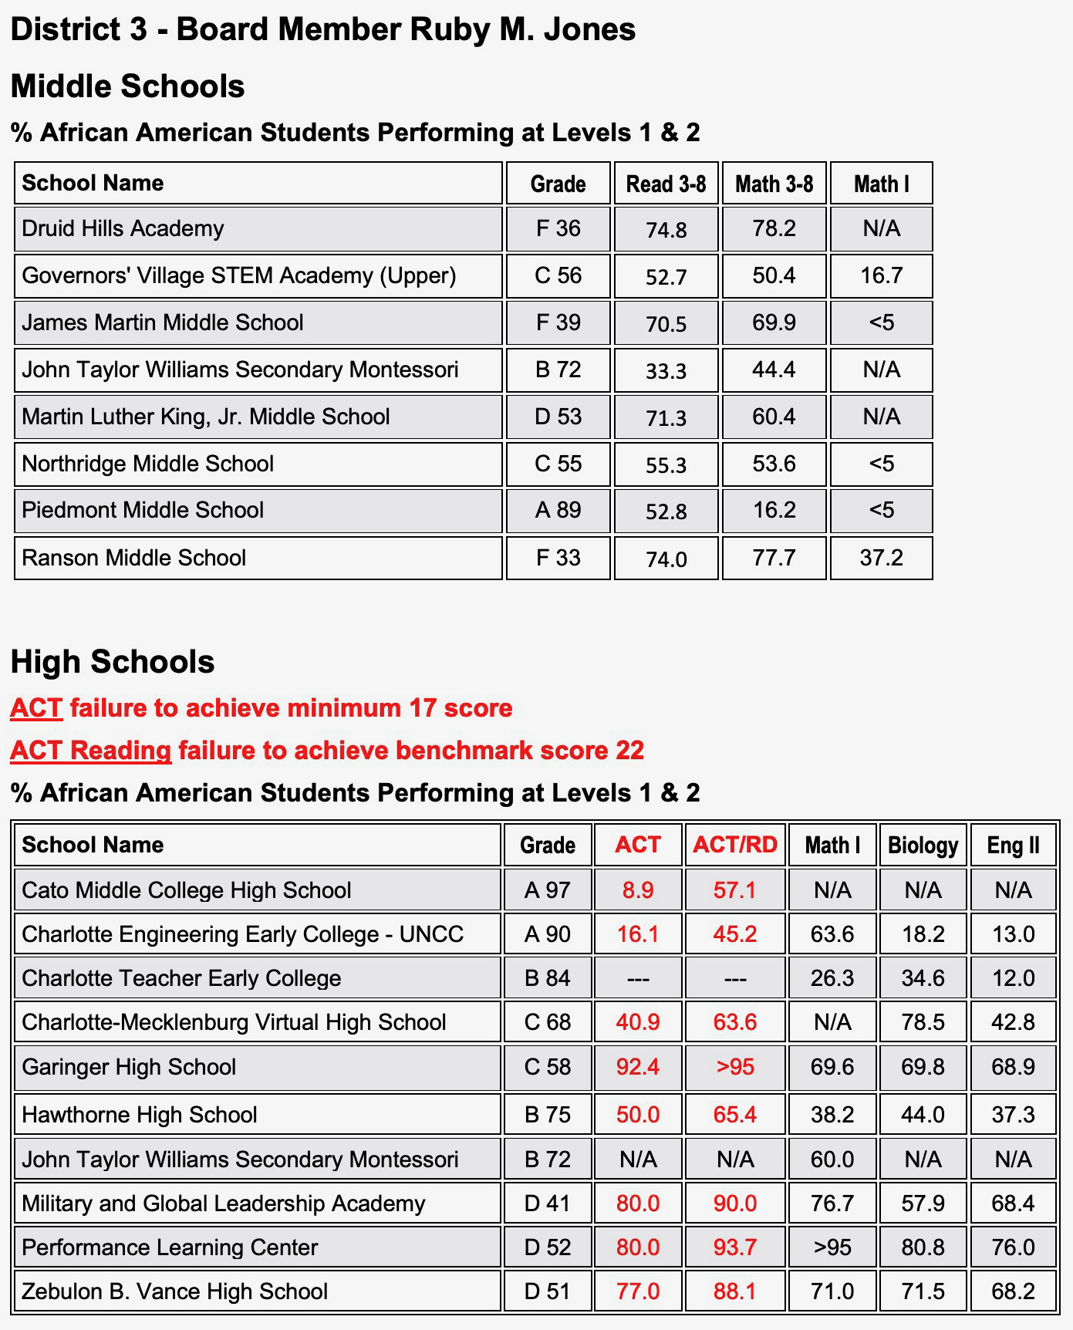
Source: NC Dept. of Public Instruction ; download at https://files.nc.gov/dpi/data-report2019_final.xlsx

Slide 11
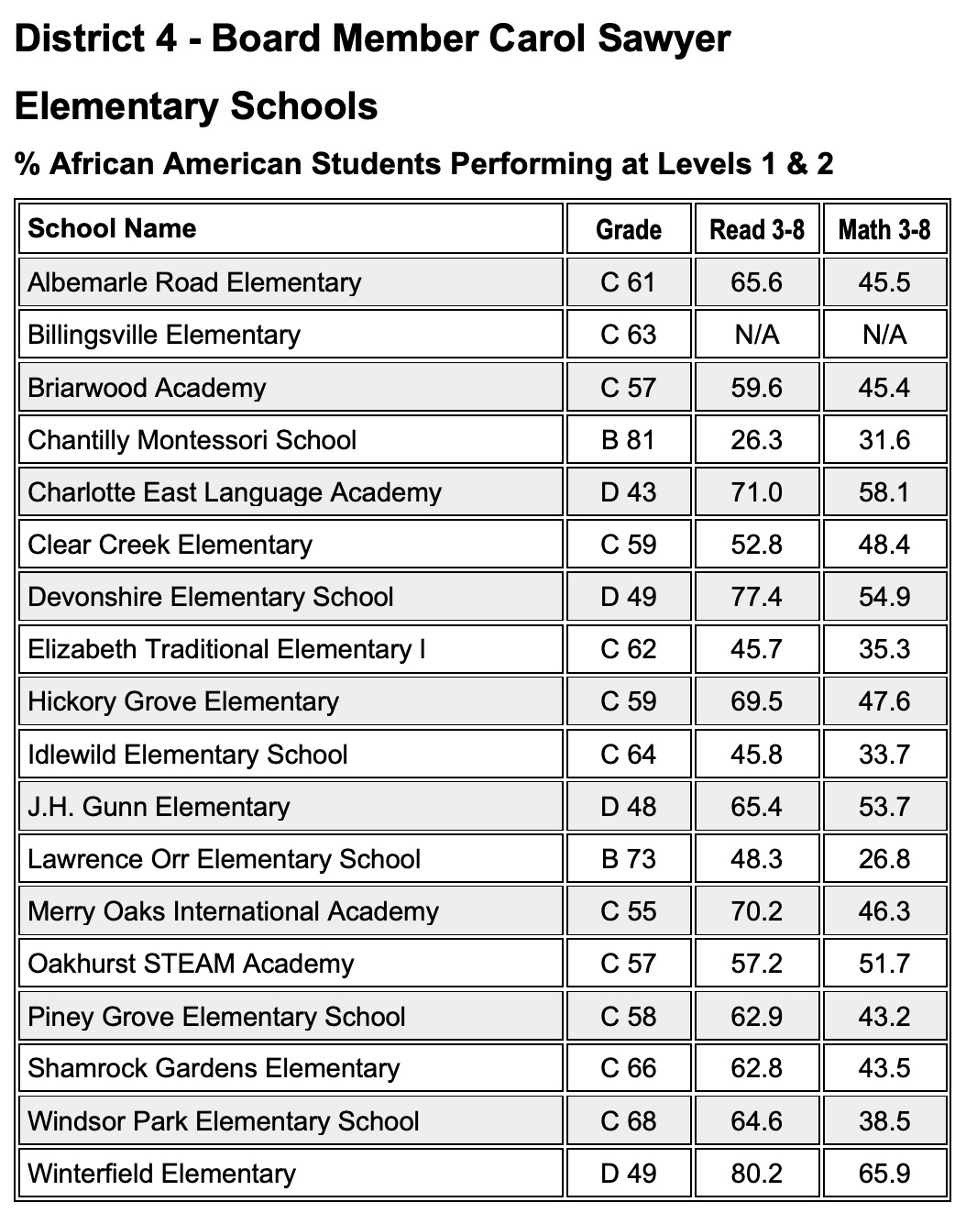
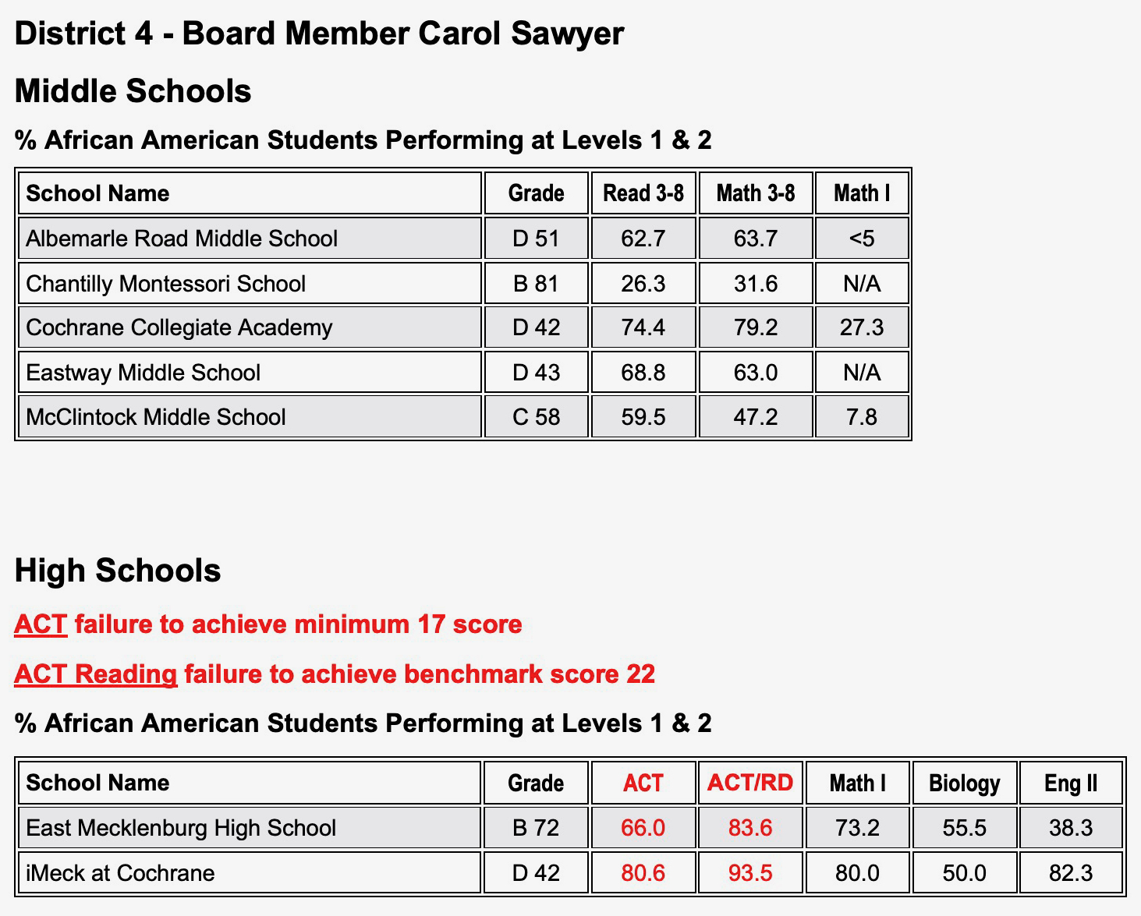
Source: NC Dept. of Public Instruction ; download at https://files.nc.gov/dpi/data-report2019_final.xlsx

Slide 12
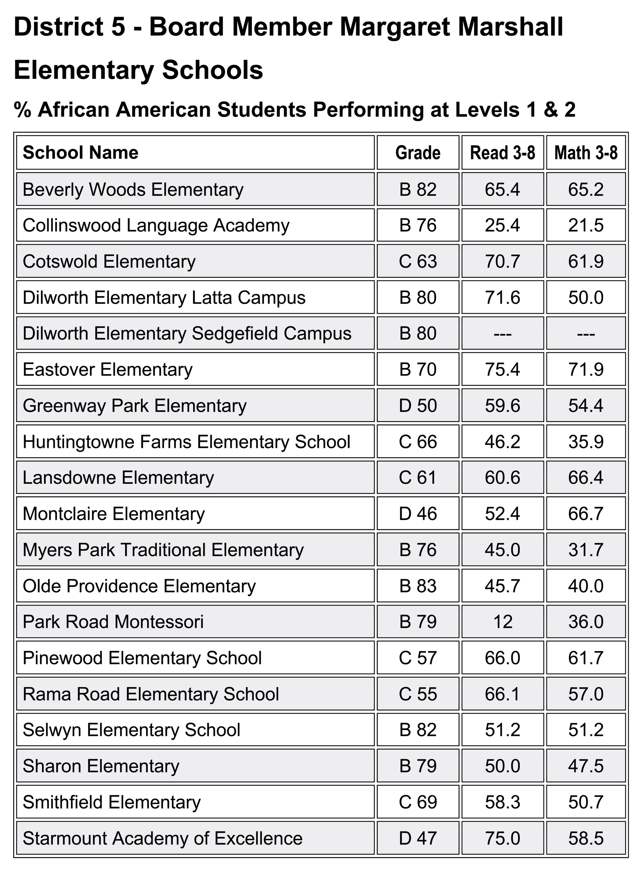
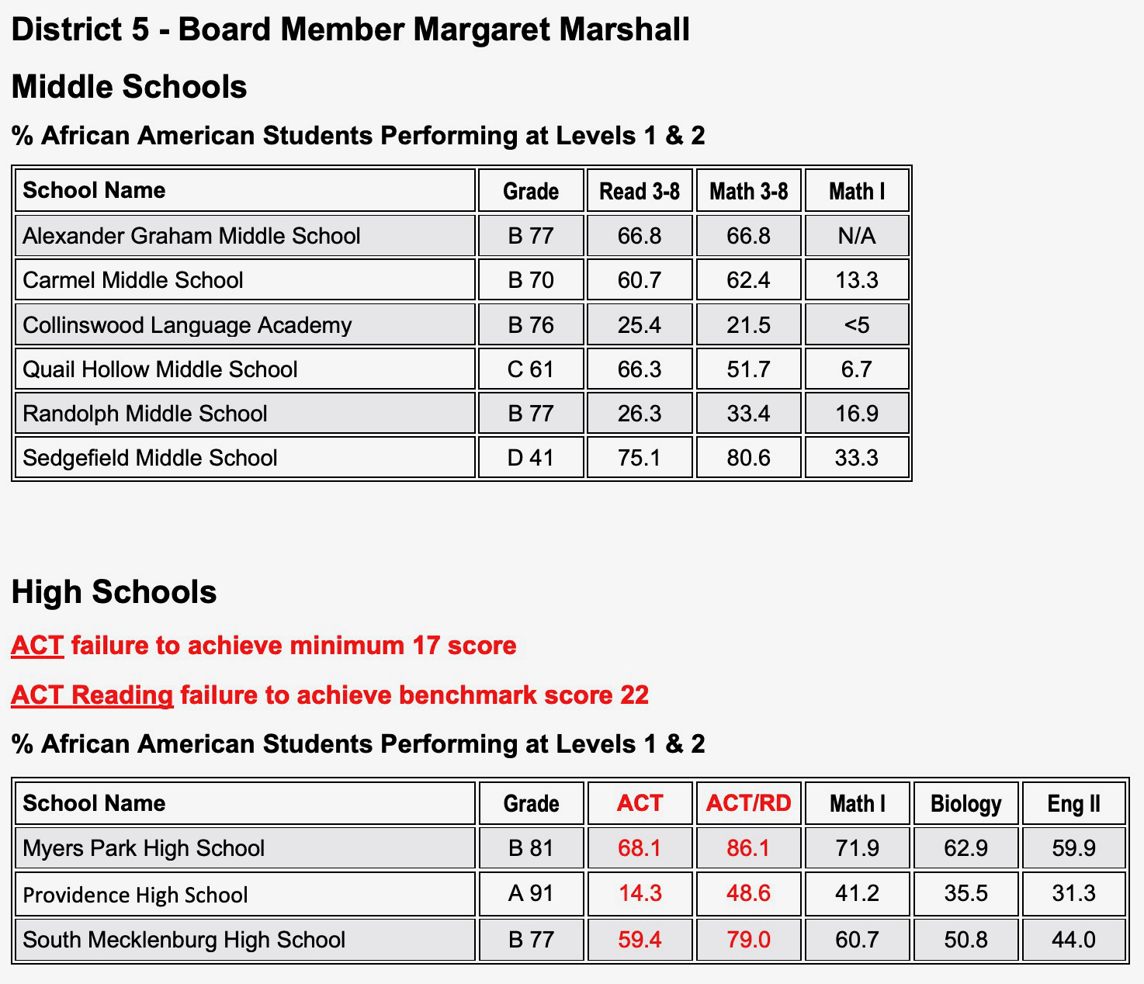
Source: NC Dept. of Public Instruction ; download at https://files.nc.gov/dpi/data-report2019_final.xlsx

Slide 13
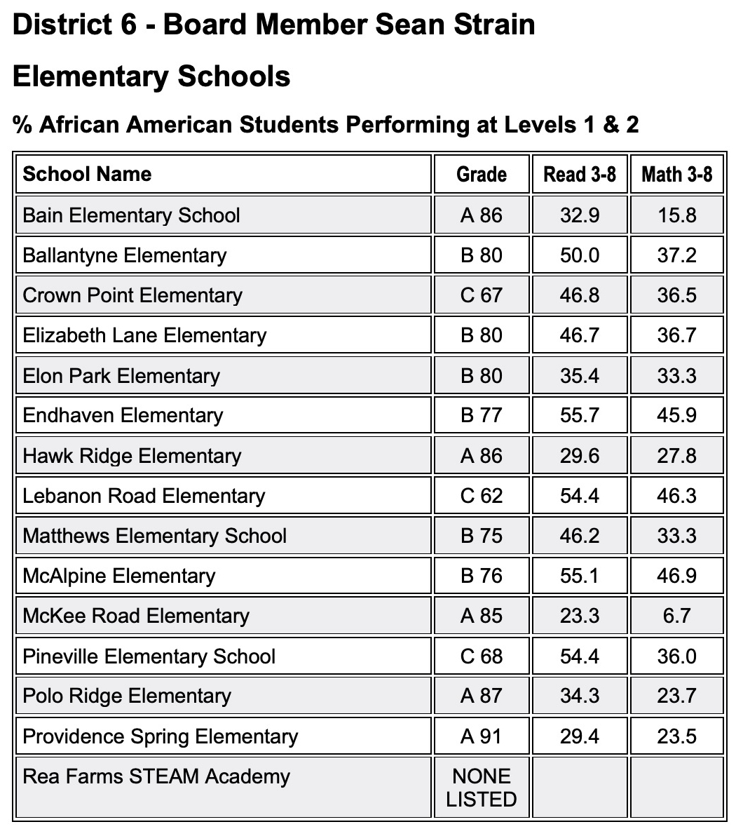
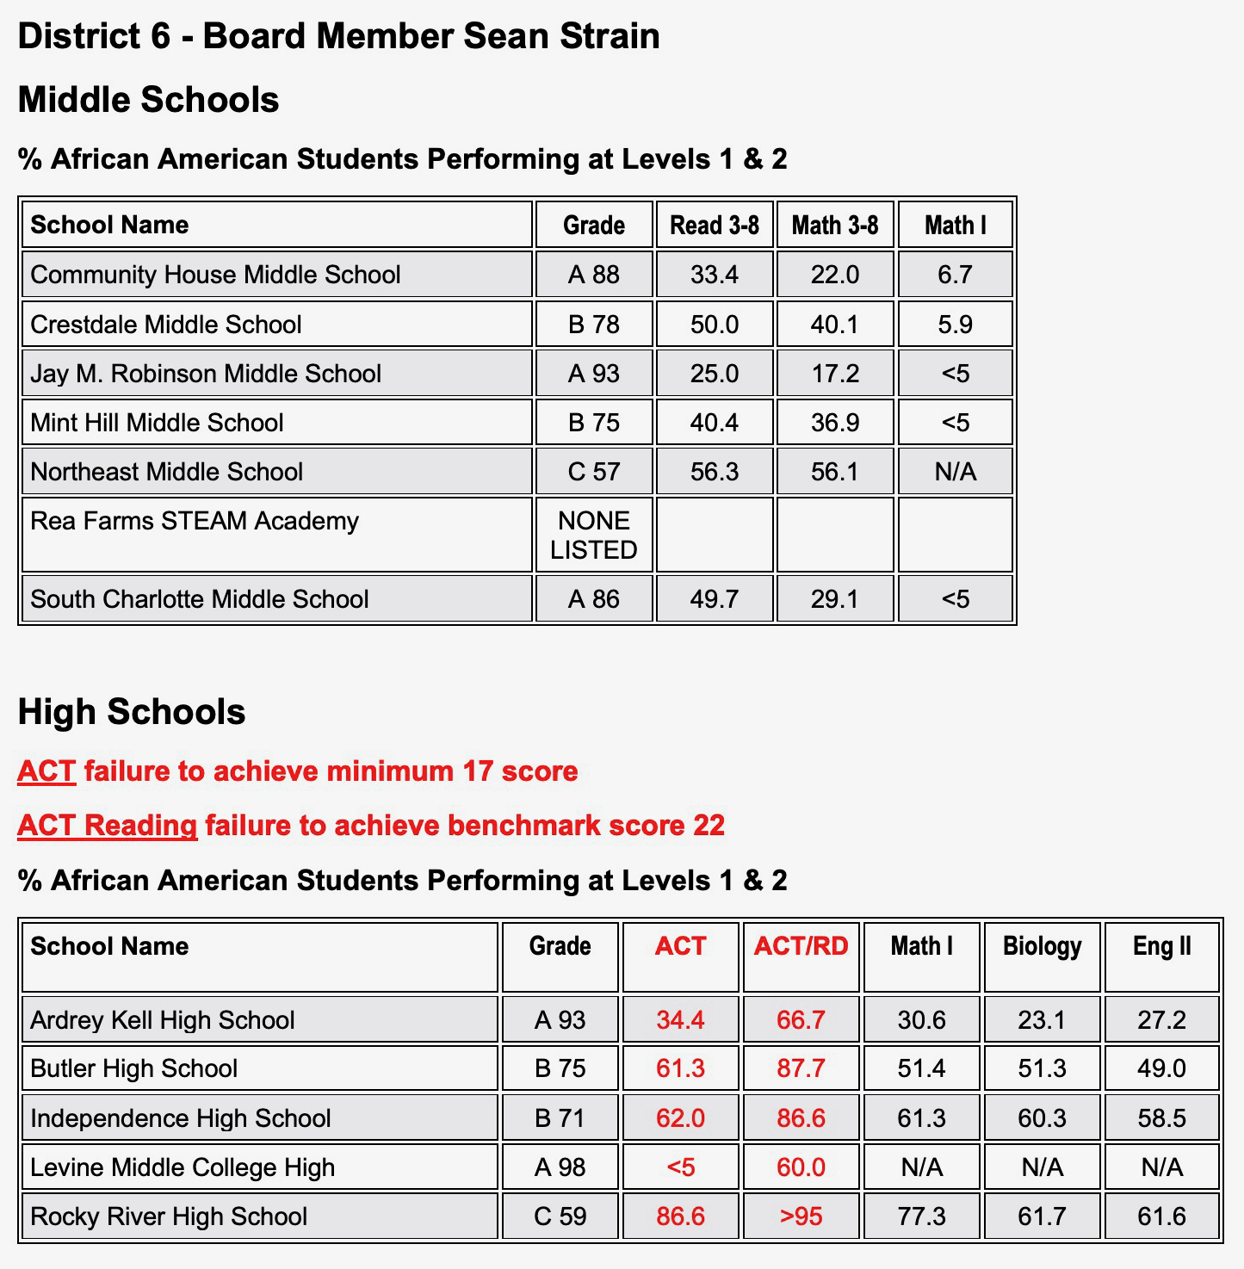
Source: NC Dept. of Public Instruction ; download at https://files.nc.gov/dpi/data-report2019_final.xlsx

Slide 14
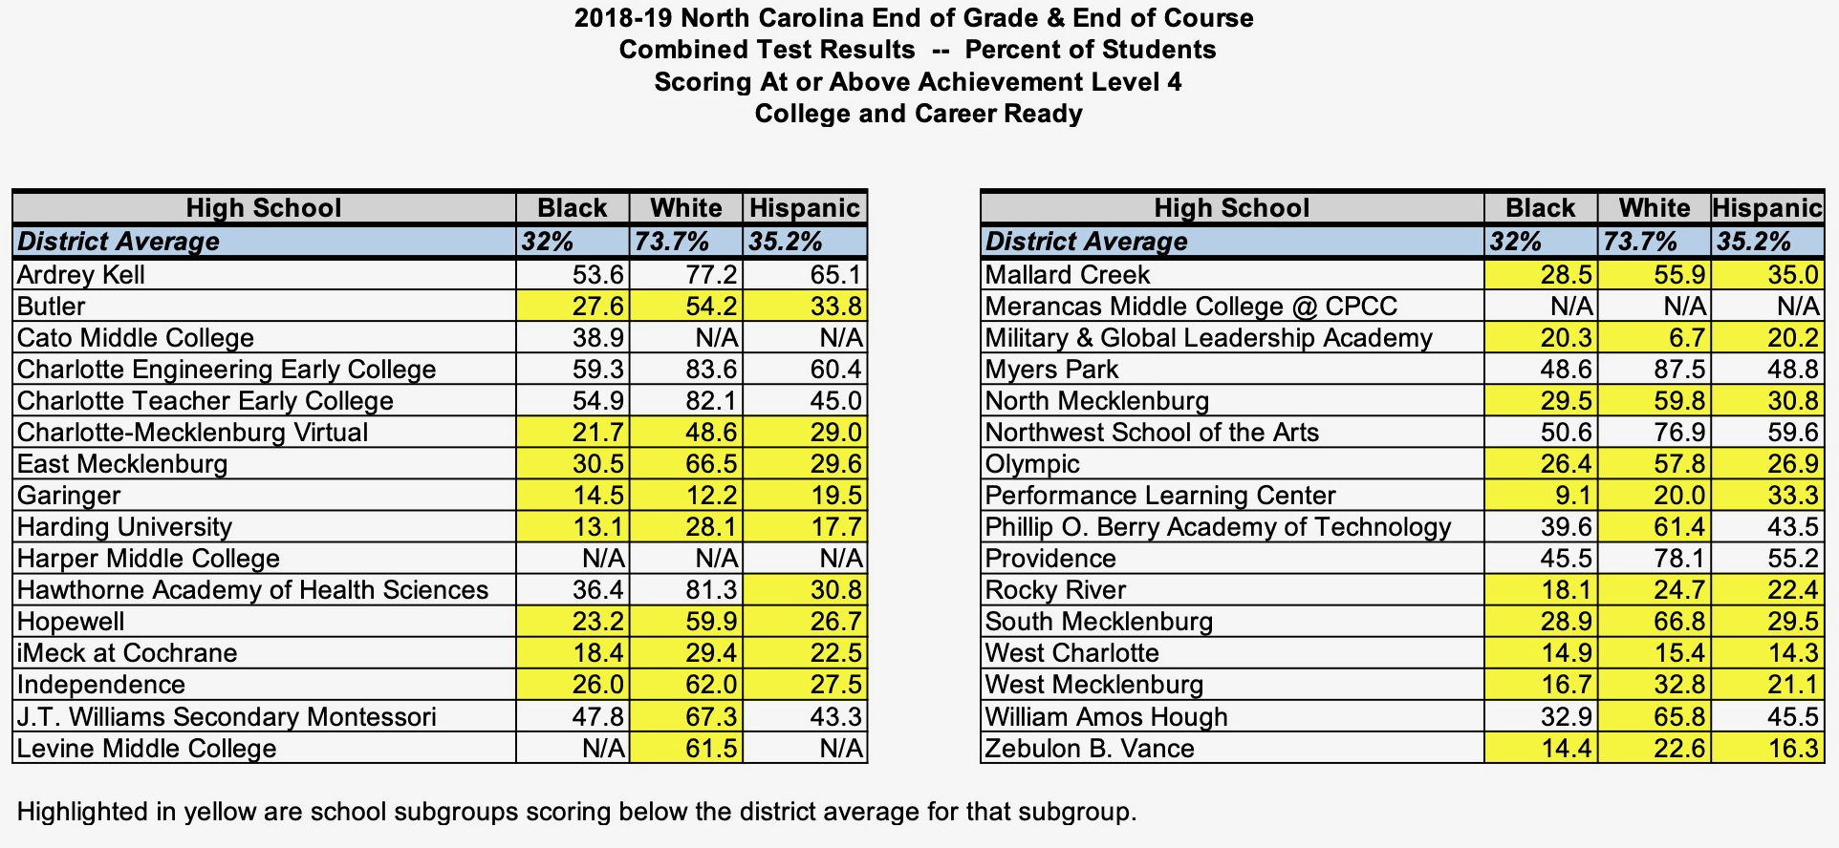

Slide 15
A Dream Deferred
Project Lift
Renaissance West Academy

Slide 16
CMS Policy
IHCC Honors Programs
              Elementary Honor Society
IKE Promotion, Retention and Acceleration
    50,900 - 3% http://bit.ly/BPCBudgetInBlack
  GCOA Teacher Contracts
    Accomplished - Distinguished

Slide 17
Arthur Griffin, Jr.
May 18, 2021

