Slide 1

Tuesday Breakfast Forum
June 7, 2011

Slide 2
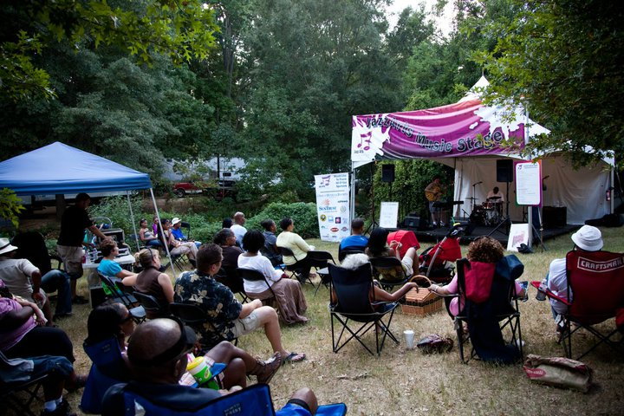
What is our mission?
Connecting the cultural community and developing an audience for jazz through quality education, performance, and musician support.

Slide 3
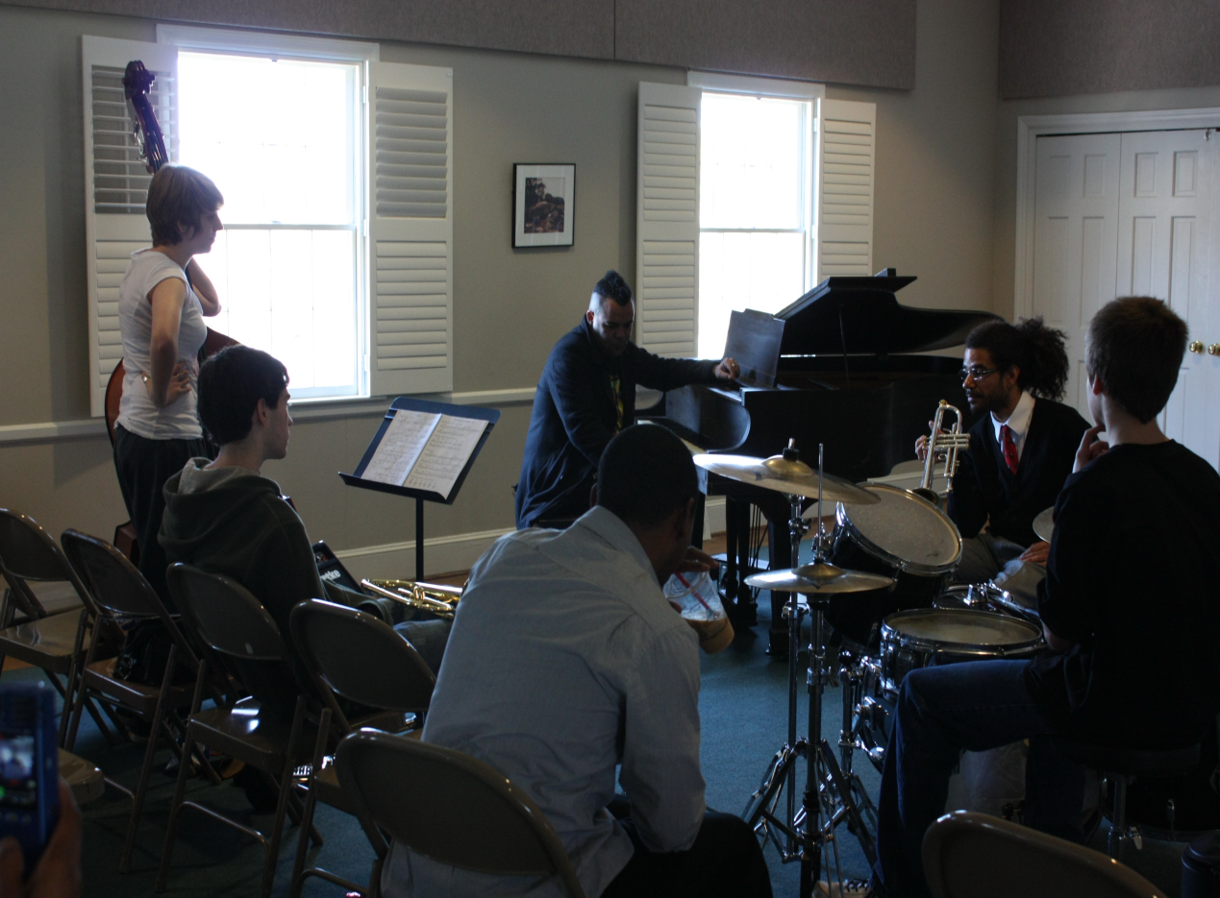
Who are we?
Non-profit 501 (c)(3) organization since 2010
  Educators
  Musicians
  Cultural Arts Patrons
  Volunteers

Slide 4
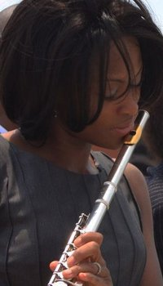
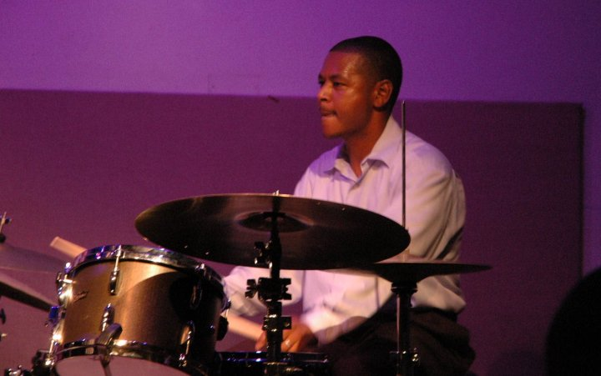
Jazz Arts Initiative Leadership
Executive Director: Lonnie Davis
Artistic Director: Ocie Davis
Board Chair: Frank Parker
Board Members: William Bambach, Barbara Edwards, Richard Harrison, Thomas Moore, Peter Sherman, Glyn Stanly

Slide 5
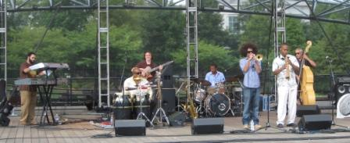
Affiliate Performing Ensemble: The Queen’s Collective
Ocie Davis, Leader, drums
Troy Conn, guitar
Tim Singh, bass
Shannon Hoover, bass
Ashlin Parker, trumpet
Robert Beasley, percussion
Stephen Gordon, piano
Carl Ratliff, Saxophone

Slide 6
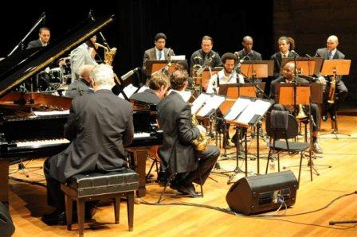
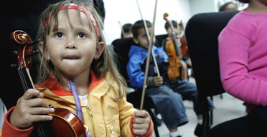
Models and Advisors
The Jazz Arts Group – Columbus, Ohio
New Orleans Jazz Orchestra (NOJO)
El Sistema (the System), Social Action for Music – Caracas, Venezuela

Slide 7
What have we done?
JazzArts Music Stage at Festival in the Park
Sept 2010
Jazz in Schools
  2010-2011
Jazz All-Stars Youth Ensemble
    Spring 2011

Slide 8
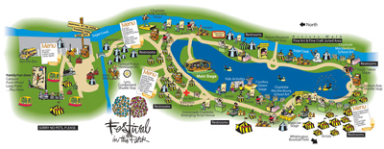
JazzArts Music Stage
21 Performances over 3 ½ days
Middle and High School Jazz Band Students
Young Adults
Professional Musicians

Slide 9
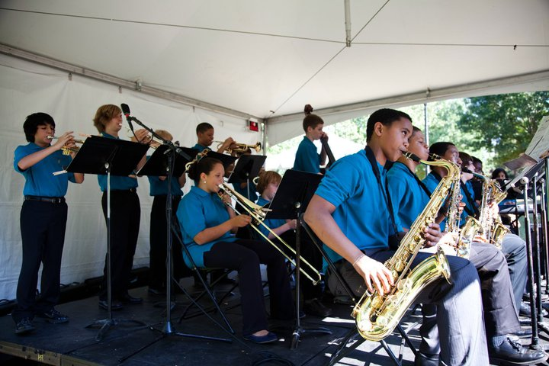
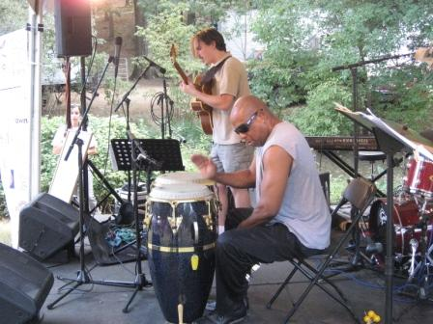
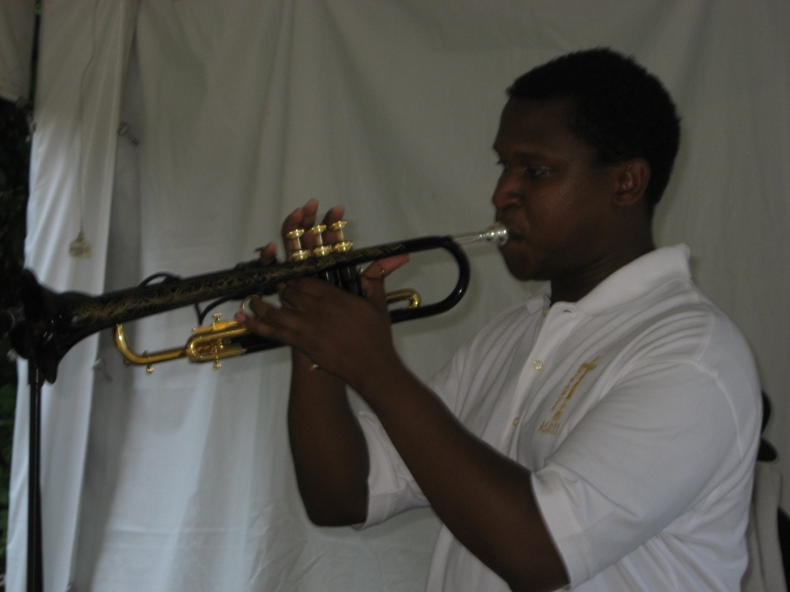
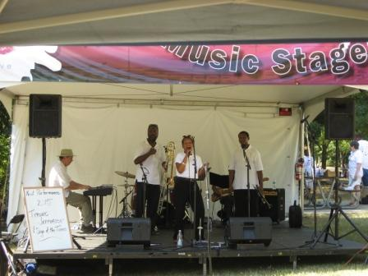
JazzArts Music Stage Performers

Slide 10
Jazz in the Schools
Three clinics in two middle schools
Two performances by the Delfeayo Marsalis Octet (NW School of the Arts, South Charlotte Middle School)
Video of Delfeayo Marsalis in School

Slide 11
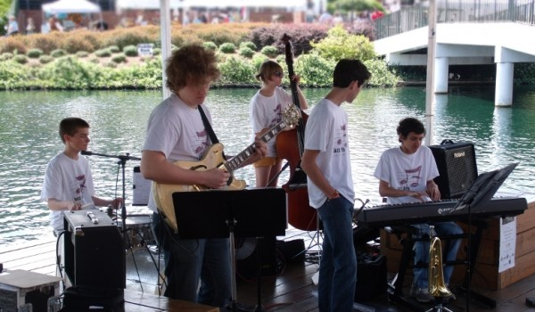
Jazz All-Stars
Selection of young musicians by audition
15 Saturdays of instruction and rehearsal
Public performance opportunities

Slide 12
All-Stars at the Mint
All-Stars Video Playing at the Mint
http://www.youtube.com/watch?v=NZ4Qp5u1tlY

Slide 13

Upcoming Projects
Jazz in the Community
  Delfeayo Marsalis Father’s Day Concert
  JazzArts Music Stage at Festival in the Park
  Jazz Stage at the Kings Drive Arts Walk
Jazz Academy
  JazzArts Music Camp
  Jazz Improvisation Institute
  Jazz Youth Ensembles
  Peanut Butter and Jazz (PB&J)
  Jamey Abersold Jazz Workshop
Jazz in Schools (2011-2012)

Slide 14
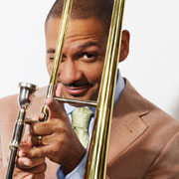
Jazz in the Community:
An Evening with Delfeayo Marsalis
Fathers Day, June 19th, 7:30pm
McGlohon Theater at Spirit Square
Opening by the
Jazz All-Stars
Tickets at $25,
$35 (VIP)

Slide 15
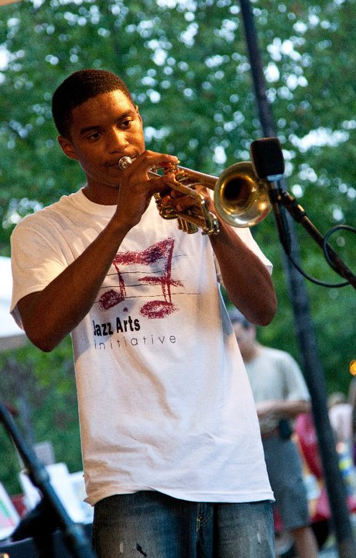
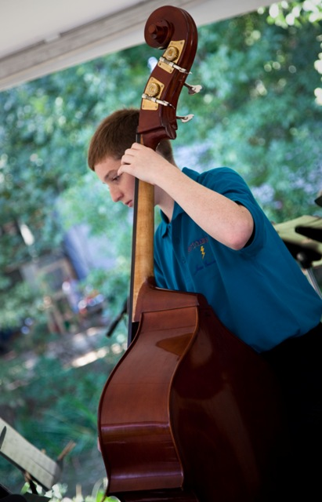

Jazz Academy:
JazzArts Music Camp
For middle and high school students
June 13-17, 9am-3pm
Providence United Methodist Church
Tuition: $250

Slide 16

Jazz Academy:
Jazz Improvisation Institute
Partnership with The JCSU Arts Factory and Smith Institute for Applied Research
Research initiative
Invitational for serious
jazz students
Multi-age participants
The Arts Factory,
  JCSU Campus
June 20-July 1, 10am-4pm

Slide 17
Jazz Academy Clinicians
Robert Beasley, percussion, UNC Charlotte
Will Campbell, saxophone, UNC Charlotte
Troy Conn, guitar, Pfeiffer University
Lonnie Davis, flute
Ocie Davis, drums, Community School of the Arts
Bill Hanna, CPCC, piano
Ashlin Parker, trumpet, Univ. of New Orleans
Carl Ratliff, saxophone, S. Char. Middle School
Chris Weise, percussion, JC Smith University

Slide 18
Jazz Arts Initiative Supporters
Grants
  Arts and Science Council, Smith Institute for Applied Research, Jazz Diva Foundation
Business and Corporate Sponsorships
  Omni Hotels, Blue Restaurant and Bar, SunTrust Bank
Hospitality Partners
  Bi-Lo Charities, Salvador Deli, Jason’s Deli, Einstein Brothers Bagels, SalSaRita’s, Fuel Pizza, Party Reflections, Omni Hotels, Blue Restaurant
Auction/Raffle Item Contributors
  Blue Restaurant, Best Buy, Target, Davidson Chocolates, Sullivan’s Steakhouse, tjreddy, Dean & DeLuca, McCormick and Schmidt, Raintree Golf Course

Slide 19
Jazz Arts Initiative Supporters
Media Partners
  Nocik Design, Wayne Powers, Tammy Greene, Jerry L, Moira Quinn, Mike Collins, Blue Planet Creative, The Charlotte Post, Creative Loafing, ASC Culture Guide
Volunteers
  Hands On Charlotte, Board Members, Friends
Internships
  Charlotte Art Institute, Johnson C. Smith University
Tuition, Tickets
  Camps, Classes, Concerts
Individual Donations

Slide 20
For more information…
Jazz Arts Initiative: www.thejazzarts.org, or call Lonnie Davis at 704-336-9350, or email info@thejazzarts.org
Tickets to the Delfeayo Marsalis Concert: www.carolinatix.org or call 704-372-1000
Jazz Camp: www.thejazzarts.org, or call Lonnie Davis at 704-336-9350
Jazz Improvisation Institute: Call Frank Parker at 704-562-7529 or email fparker@jcsu.edu

