Slide 2
Connecting the dots

Slide 3
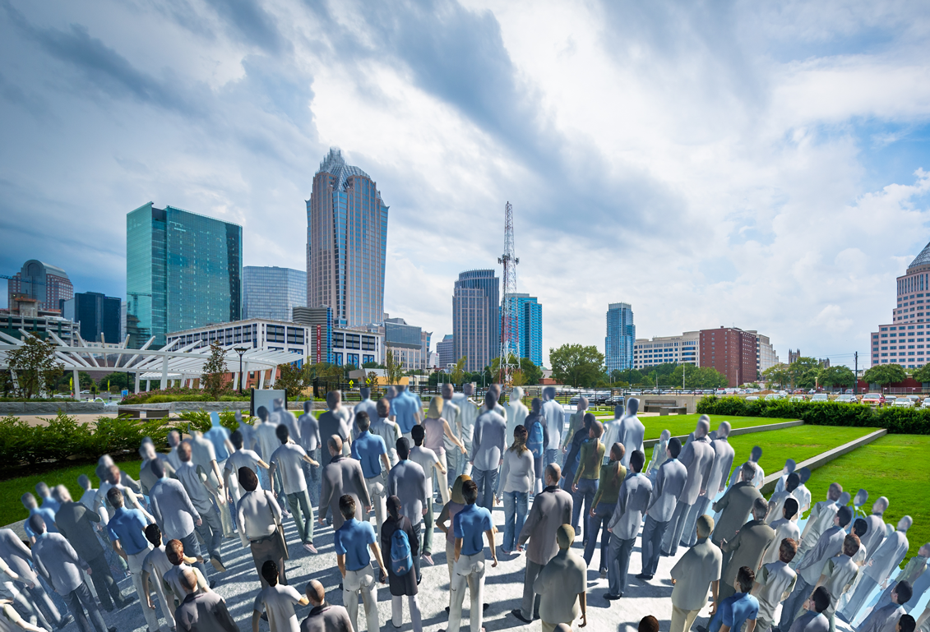
We are growing… +400,000 people
44 new residents per day
Over 1.2 million by 2040

Slide 4
Trends are positive…
Tourism is on the rise
5.9 % increase in tourism revenues
124,000 area jobs are provided by the hospitality industry
$6.5 billion estimated in annual visitor spending
Residential real-estate market is recovering
7.8 % growth rate in median home sales price over the
last five years
6.9% increase in new home listings
year over year
15.7% increase in pending home sales year over year
Jobs and wages are trending up
Over the last 5 years:
3.8% average annual increase in employment
5.5% average annual increase
in-commuters
Average annual
wages increased
0.9%
Construction is booming
Over the last 5 years:
Additional 11 million square feet in commercial space
24,000 new multi-family units

Slide 5
All residents must share in our success
ACUTE SHOCKS
CHRONIC STRESSES

Slide 6
6

Slide 7
Resources are aligned with the Community Letter
Safety Staff Resources and Programming
Safety Capital $22.4 million
Housing
Staff Resources and Programming
Community Letter
$1.0 million
Housing Capital $6.0 million
Jobs
Staff Resources and Programming
Jobs Capital $8.5 million

Slide 8
Proposed FY 2018 Budget is structurally balanced
Expenditures $2.39 Billion
Revenues $2.39 Billion

Slide 9
Proposed FY 2018 General Fund Budget is structurally balanced
Expenditures $668.5 Million
Revenues $668.5 Million

Slide 10
Proposed FY 2018 Budget represents a 5.3 percent increase from FY 2017
5.3% increase

Slide 11
Overview of key General Fund increases
Compensation and Benefits
Public Safety Increases
78% of total General Fund Increase

Slide 12
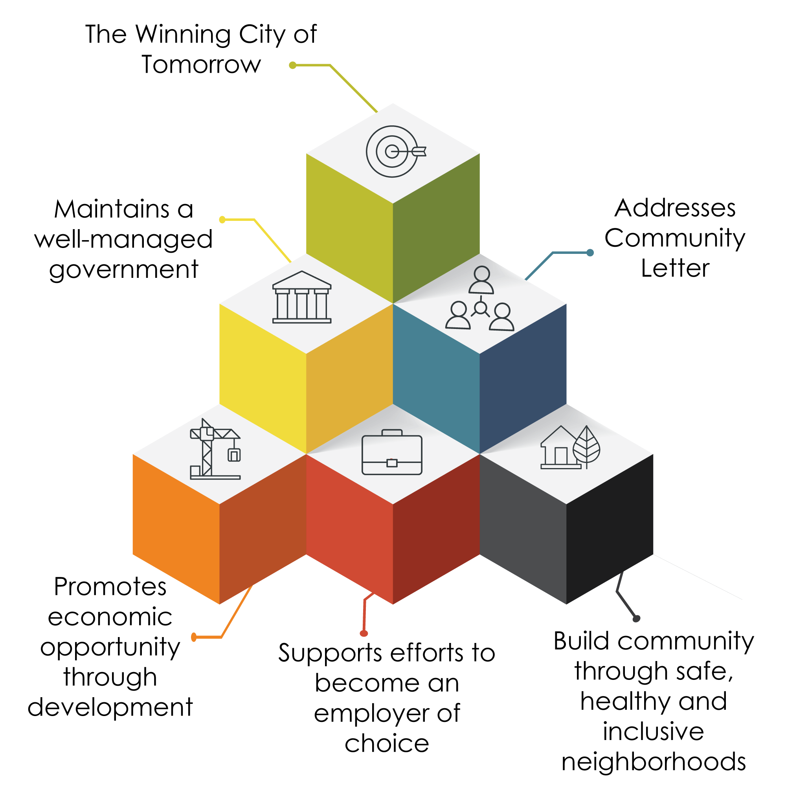
FY 2018 Budget building blocks

Slide 13
Well-Managed Government

Slide 14
Sound fiscal leadership
Adherence to budget principles
Maintained AAA credit rating on General Obligation debt for 44 consecutive years
14

Slide 15
Resource constraints
15

Slide 16
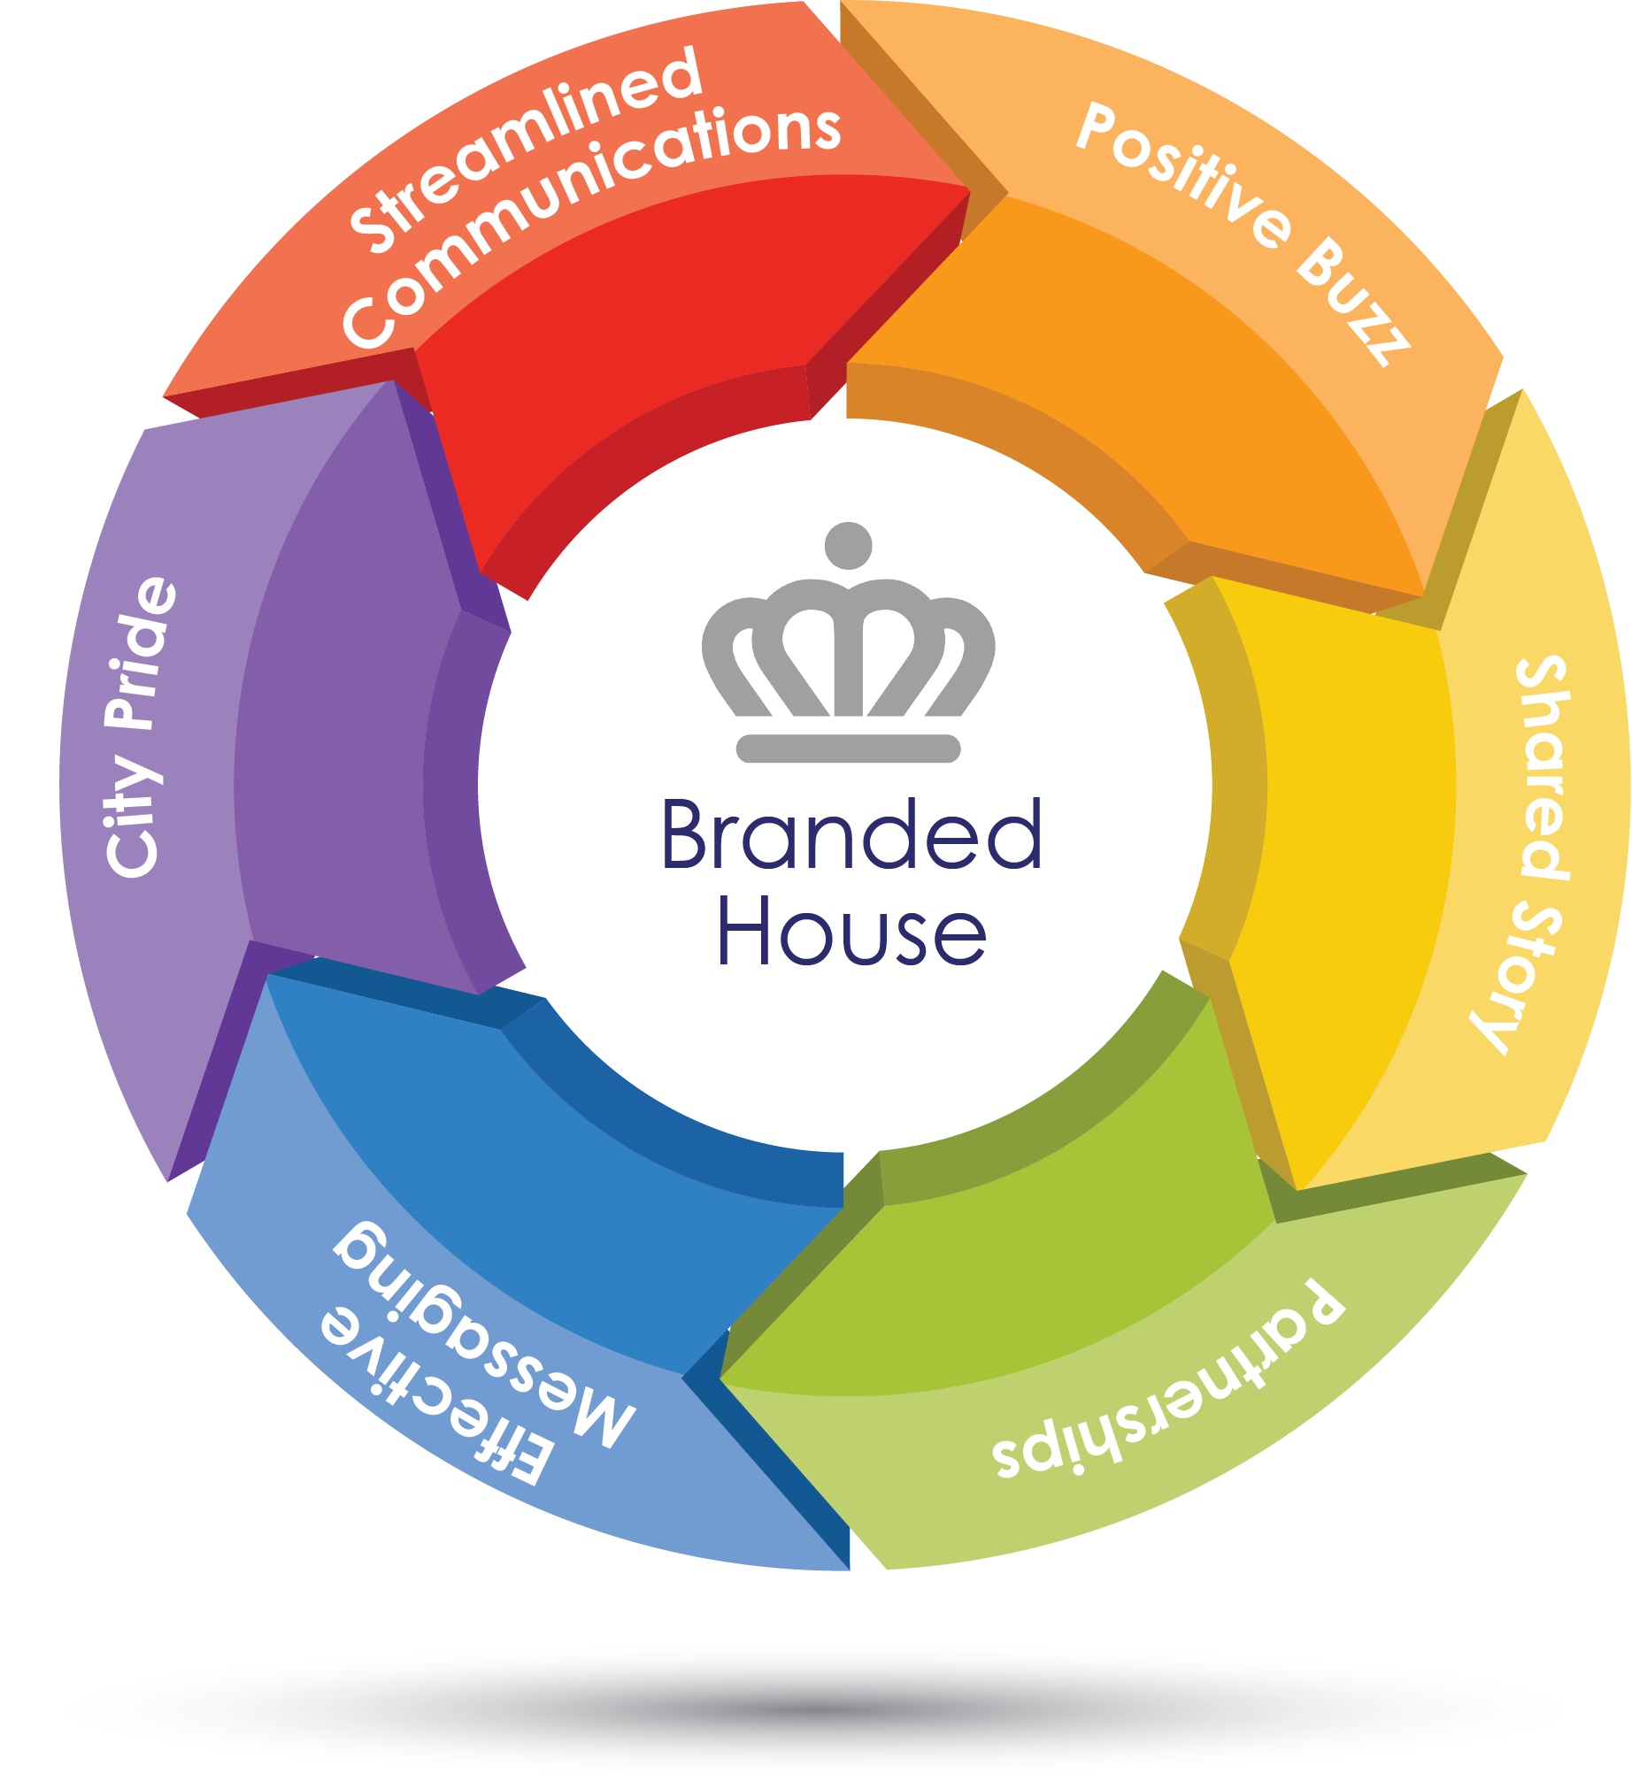
Realigned to support our Focus Areas
Renewed commitment and strategic departmental alignment with Council Focus Areas:
Community and resident engagement
Housing and Neighborhood Services
Economic Development
Revisions to performance management approach
Consistent branded efforts citywide

Slide 17
Presentation overview
Community building through strong neighborhoods
Letter to the Community
Safety, Trust, and Accountability
Affordable Housing
Good Paying Jobs
Employer of Choice

Slide 18
Building Community Through Strong Neighborhoods

Slide 19
Building community
Neighborhoods play a key role in building a strong community

Slide 20
Building strong neighborhoods through public investment
$6.0 million Neighborhood Transportation Safety Corridors
$525,000
Code Enforcement to address Neighborhood blight
$3.0 million Neighborhood Transportation Program
$1.4 million
Americans with Disabilities Act
sidewalk enhancements
$375,000
Neighborhood Matching Grant Program

Slide 21
Engaging residents, creating positive buzz
Civic Leadership Academy
Neighborhood Matching Grants
21
21

Slide 22
Safety, Trust and Accountability

Slide 23
Building Safety, Trust, and Accountability through public investment
Completed phased investment of
125 Police Officers and additional civilian positions
Engine company 65
at station 42
Enhanced
community engagement
Public Safety
pay plan adjustment

Slide 24
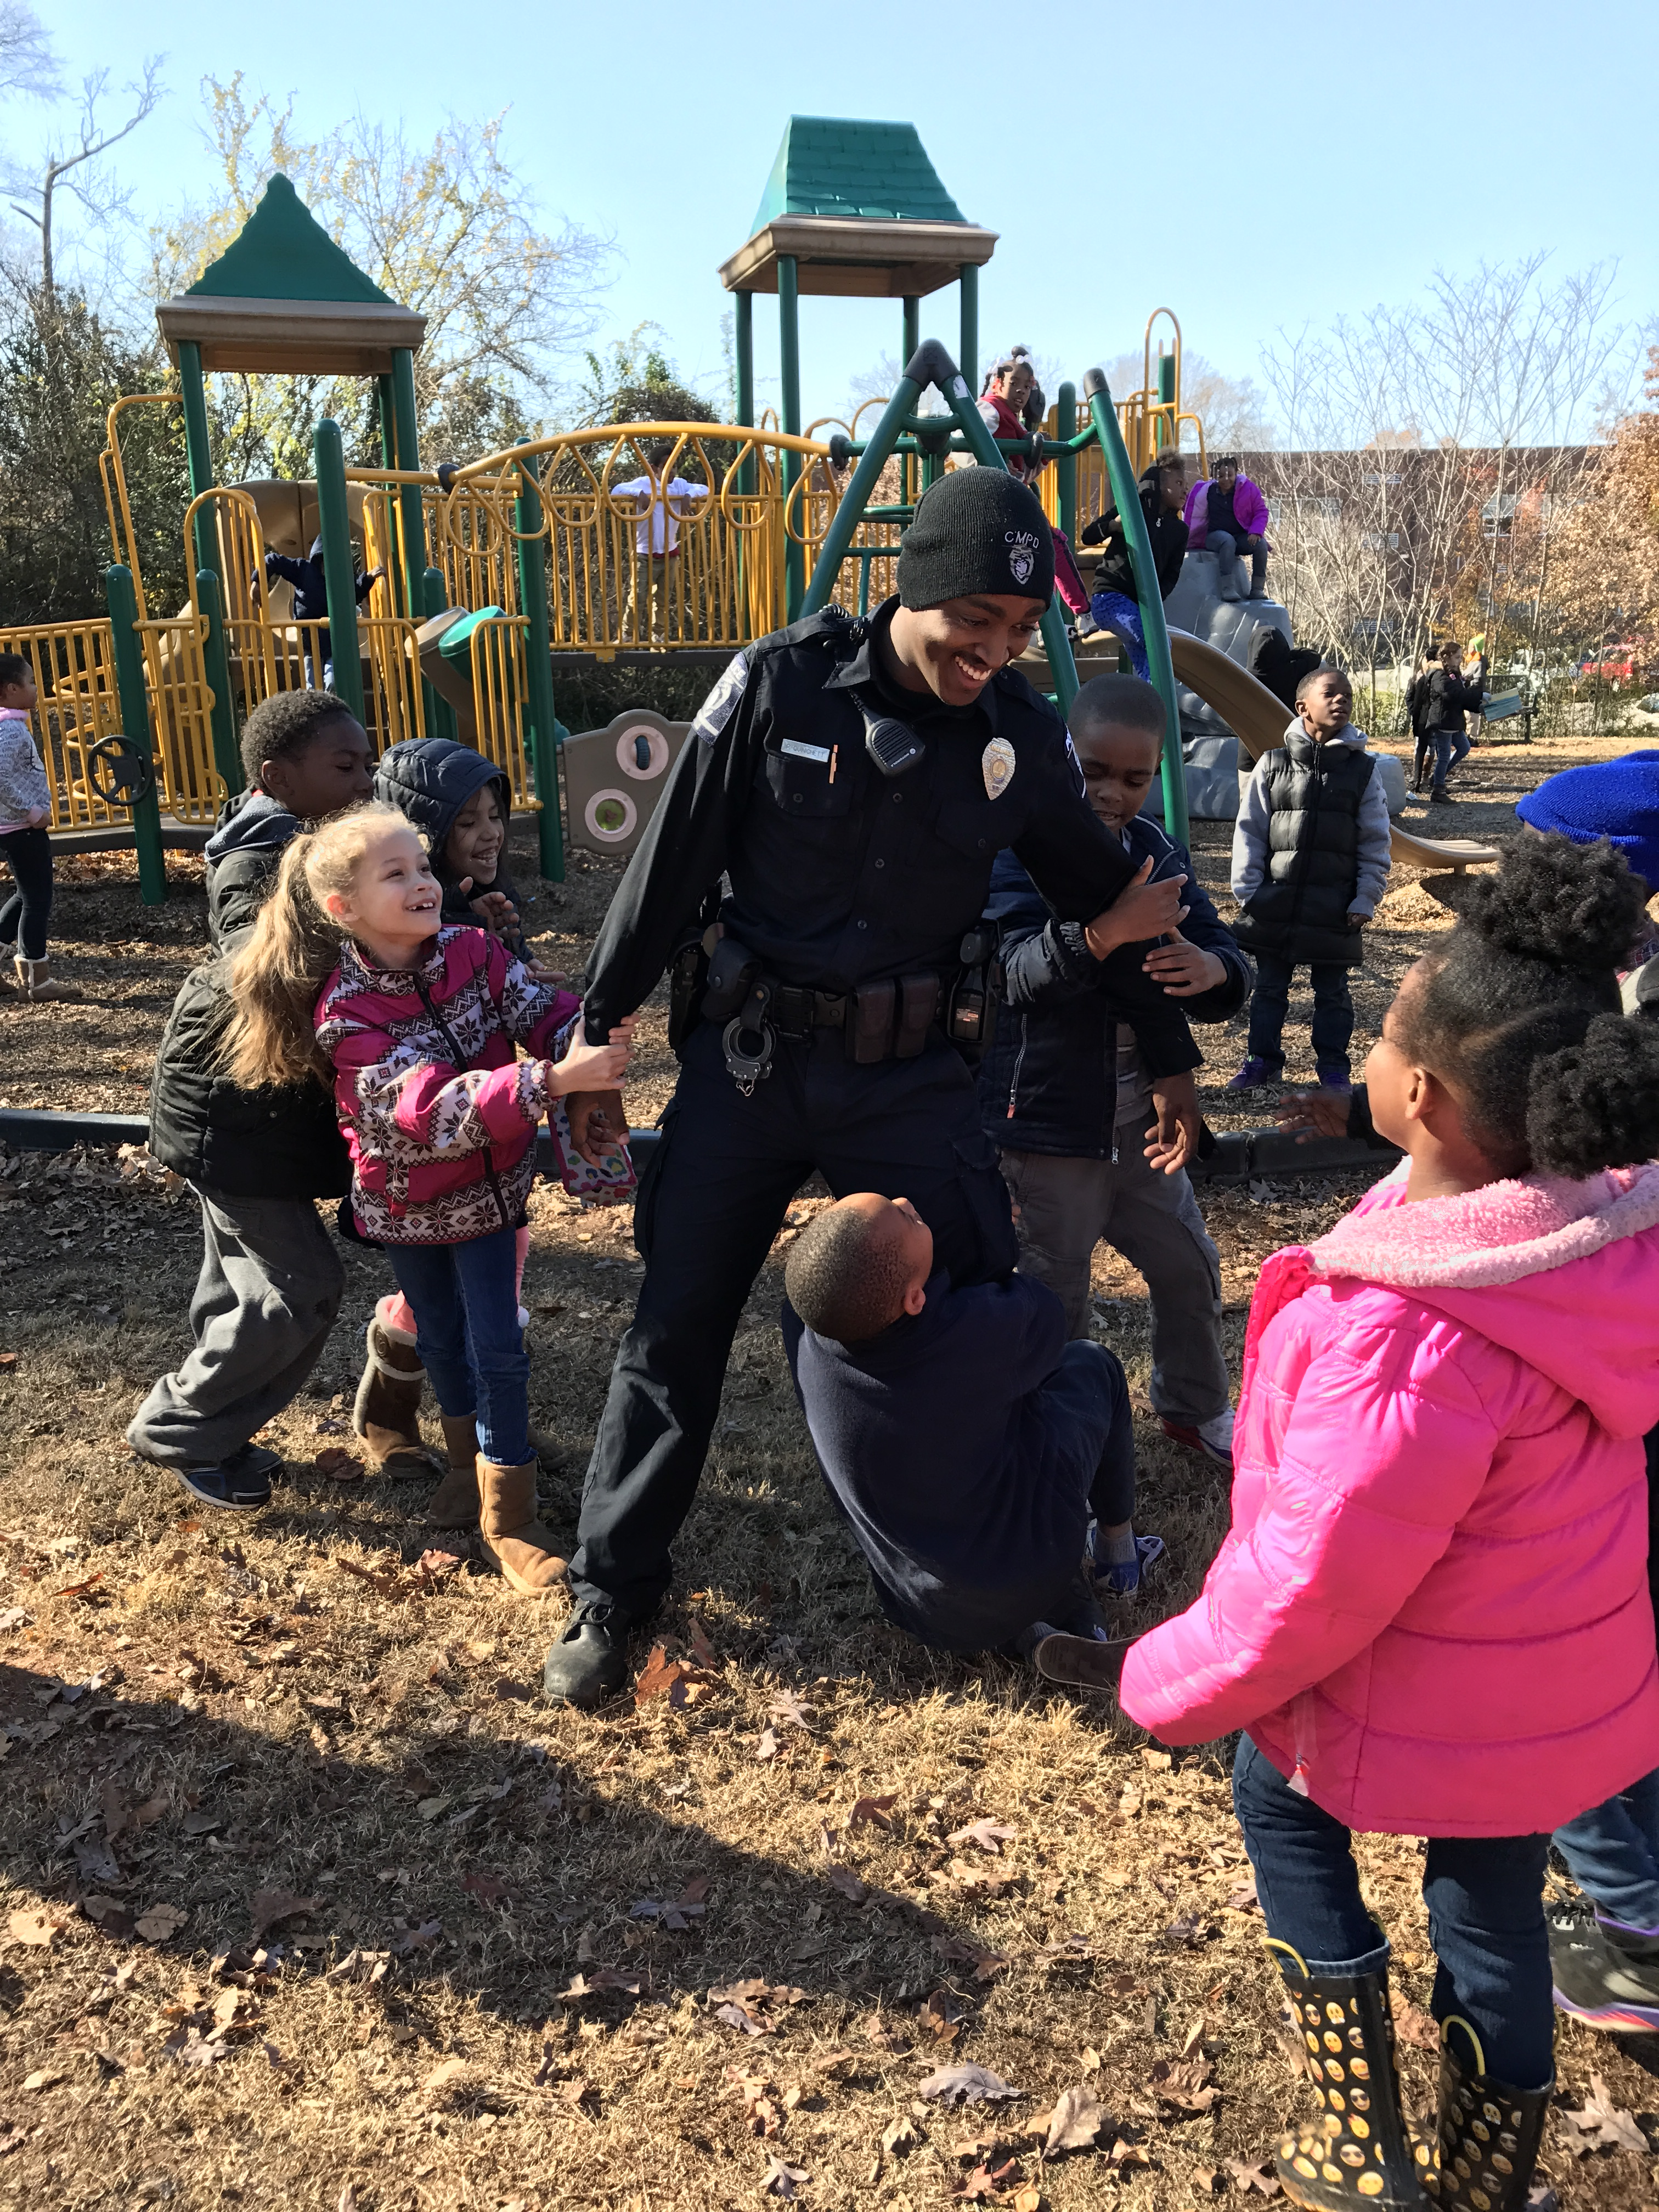
Community outreach initiatives
Community safety town halls
Transparency workshops
Juvenile diversion program
Conflict management and diversity training
Neighborhood problem solving

Slide 25
Affordable Housing

Slide 26
Building affordable housing through investment and collaboration
$6.0 million additional for affordable housing initiatives
Creation of Department of Housing and
Neighborhood Services
Comprehensive and coordinated solutions
$200,000 for Housing Rehabilitation Program

Slide 27
Working towards City Council’s goals
Reaching the goal of 5,000 Affordable Housing Units
Remaining Goal
Over 1/3 of Goal Met

Slide 28
Good Paying Jobs

Slide 29
Creating good paying jobs through partnerships and investment
$5.0 million Business Corridor Revitalization
Creation of the Department of
Economic Development
$3.0 million completion of the North Tryon Redevelopment Project
Provide additional resources for city programs

Slide 30
Career readiness will support job creation
Youth career awareness programming
Career pathways and jobs skills training
Apprenticeship programming
Youth Programs
Adult Programs

Slide 31
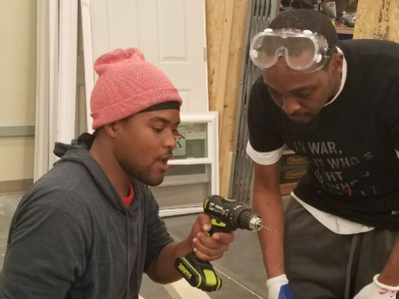
Apprenticeship opportunities
Project P.I.E.C.E. with Goodwill Industries
Citywide Apprenticeship Program

Slide 32
Aviation Institute of Maintenance AIM-Charlotte
New Federal Aviation Administration (FAA) certified Aviation Mechanic Training Program
Scheduled to open early 2018 (pending accreditations)
21-month program, training students in all areas of aviation maintenance
500 students annually
Estimated starting salary upon
program completion is $46,000
Tuition free scholarships to two Charlotte residents

Slide 33
Employer of Choice

Slide 34
Becoming an Employer of Choice through engaging employees
3% broadbanding merit increase; 2% market increase for sworn officers
Dynamic healthcare options
Career ladders and
career pathways
Increasing minimum pay
Employer sponsored volunteer day

Slide 35
Setting an example as a Employer of Choice
City practice and minimum pay recommendation
City minimum pay = 60 % of Area Median Income
Goal to bring minimum starting pay to $15 per hour by FY 2020
Accelerating FY 2018
Minimum Pay: $15 per hour
($31,200)

Slide 36
Proposed FY 2018 Proposed Budget (All Funds)
General Fund
No tax increase
Minimal Solid Waste fee increase due to contractual escalations (50¢ per month)
Aviation
Maintains lowest per emplaned passenger rate among all large-hub airports
Charlotte Area Transit System
No fare increase
Charlotte Water
$1.73 monthly rate increase
Storm Water
No rate increase

Slide 37
FY 2018 Budget calendar
May 8 – Council Budget Public Hearing (5:30 p.m.)
May 10 – Council Budget Adjustments (1:00 p.m.)
May 24 – Council Straw Votes (12:00 p.m.)
June 12 – Council Budget Adoption (7:00 p.m.)

